Slide 1
INDUCTION MOTOR ANALYSIS USING OBJECT-ORIENTED PROGRAMMING (23ELC202)

Slide 2
Team Members:
Dharshavardhan-CB.EN.U4ELC24014
Jayanth M- CB.EN.U4ELC24020
V.S.Shridarshan - CB.EN.U4ELC24045
Dhevan S- CB.EN.U4ELC24031

Slide 3
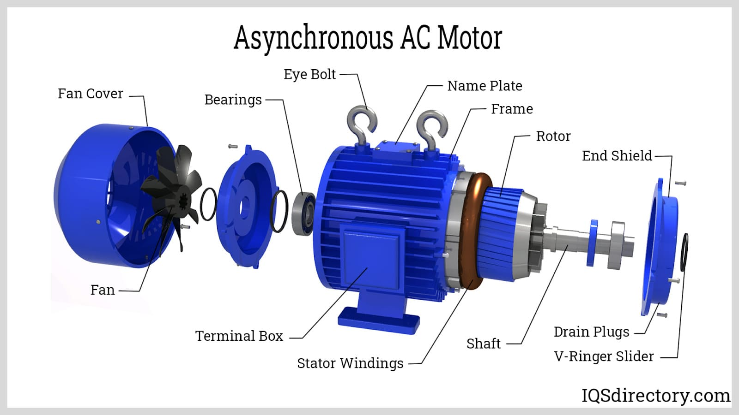
Parts of Induction Motor

Slide 4
Induction Motor Essentials
Induction motors are the workhorses of industrial drives.
Operate based on electromagnetic induction.
Power transfer occurs without direct electrical connection between stator and rotor.
The analysis focuses on torque, speed, slip, and efficiency.

Slide 5
Working Principle
• The rotating magnetic field (RMF) generated by the stator induces current in the rotor.
• Rotor current interacts with RMF to produce torque.
• Slip determines the difference between synchronous and rotor speeds.

Slide 6
Design & Mathematical Formulations
Ns = (120f / P) — Synchronous Speed (RPM)
Input Power = √3 × V × I × pf
Slip = (Ns - Nr) / Ns
Torque = (60 × E₂² × R₂ × s) / (2πNs((R₂)² + (X₂s)²))
Efficiency = (Pout / Pin) × 100

Slide 7
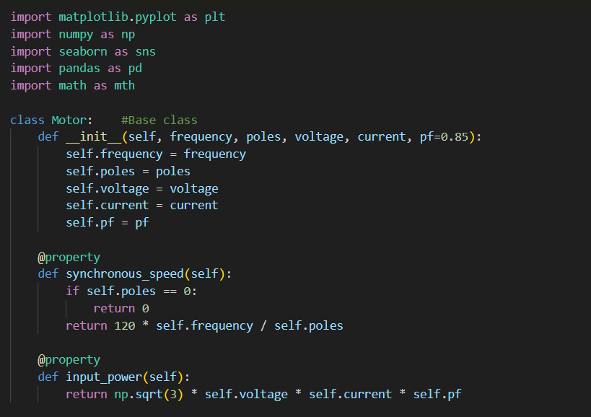
Code :
Code:

Slide 8
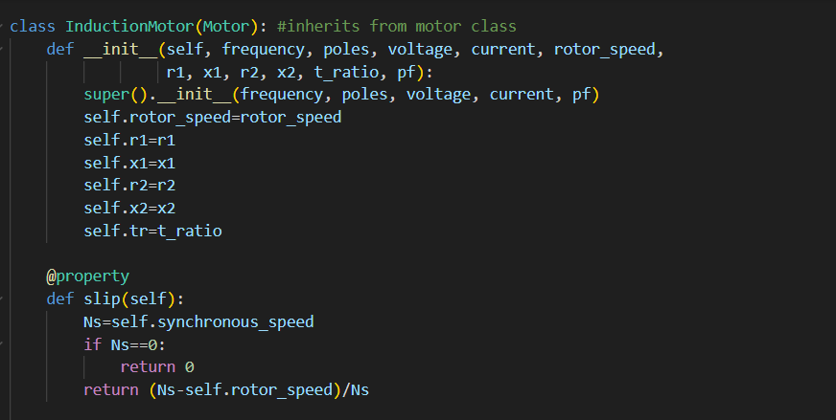

Slide 9
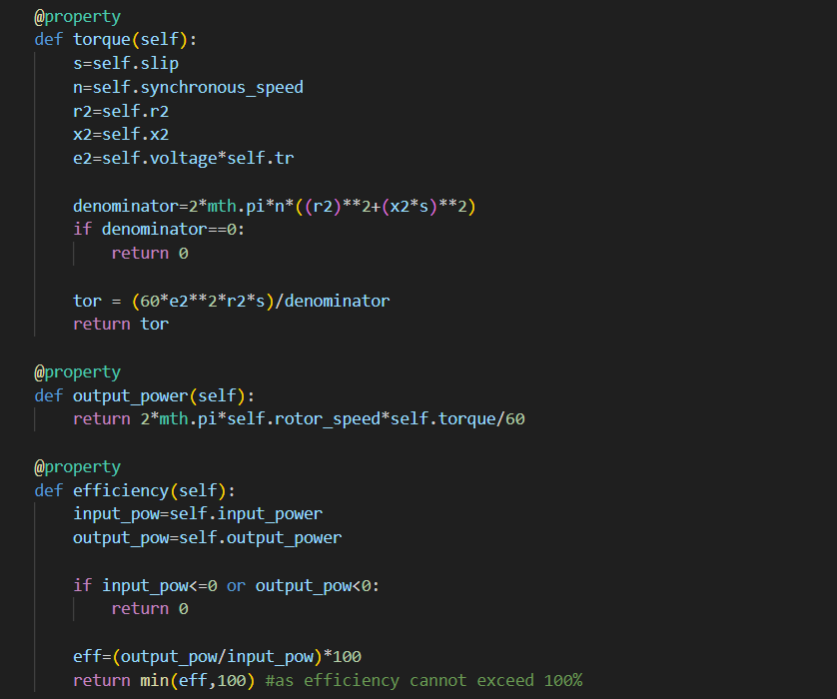

Slide 10
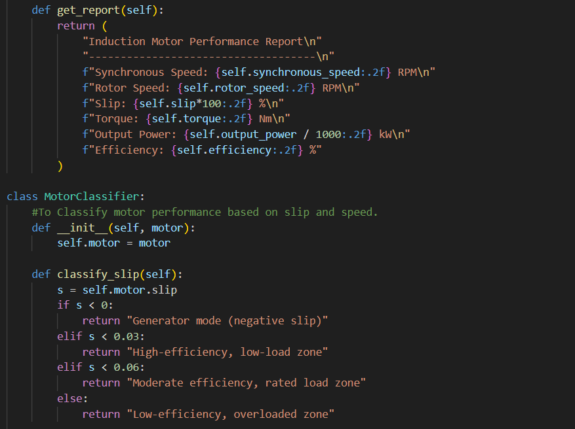

Slide 11
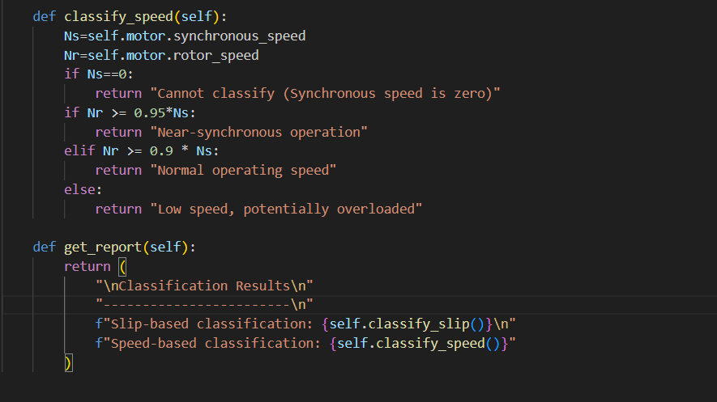

Slide 12
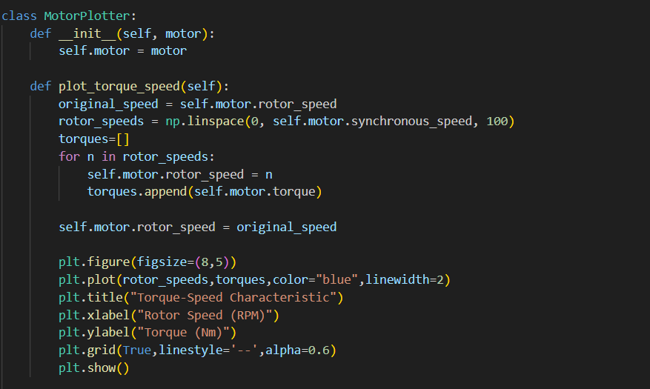

Slide 13
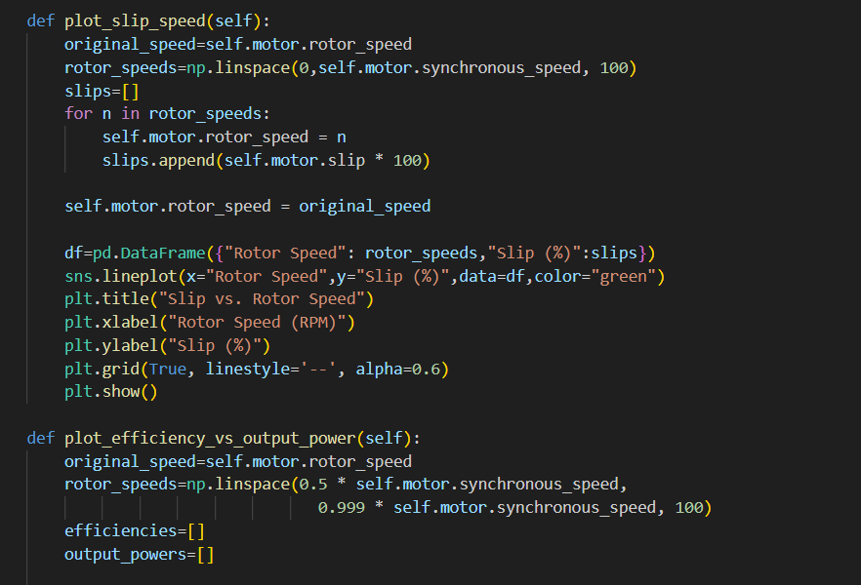

Slide 14
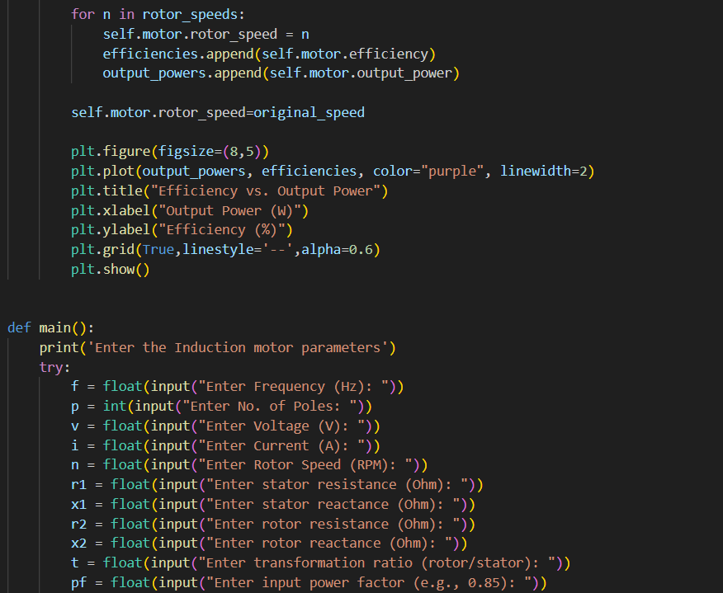

Slide 15
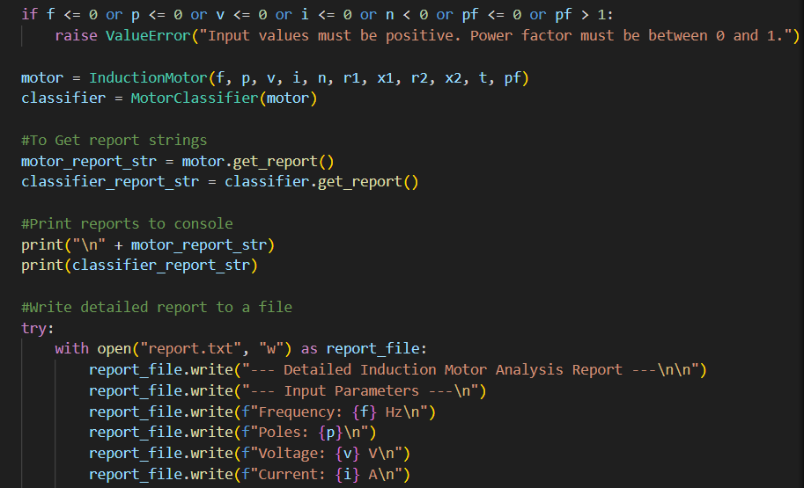

Slide 16
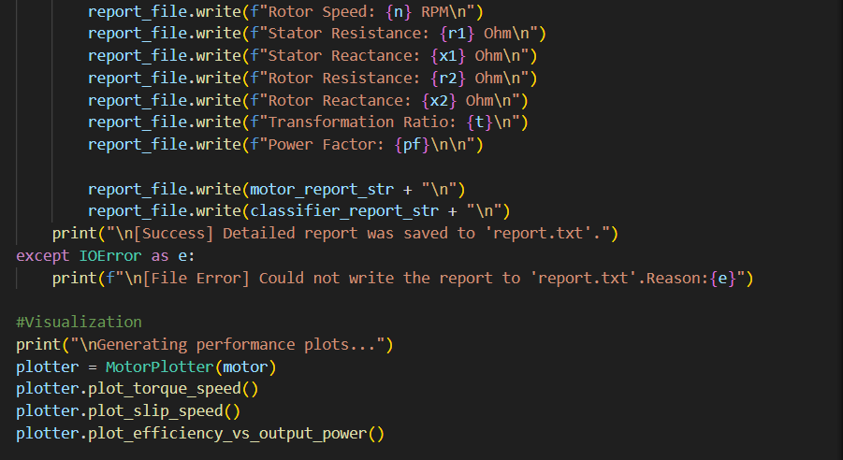

Slide 17
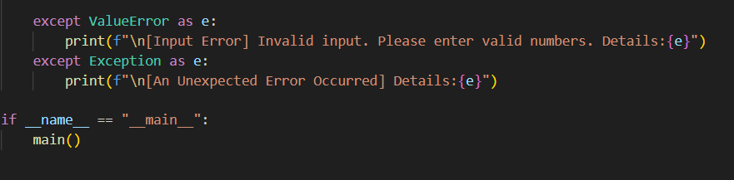

Slide 18
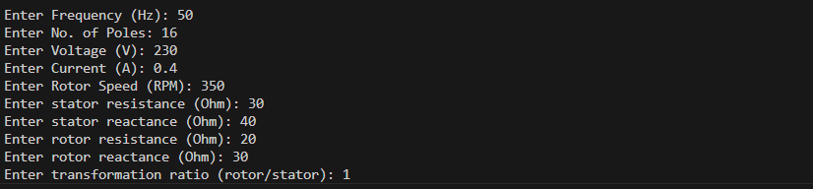
Sample input :

Slide 19
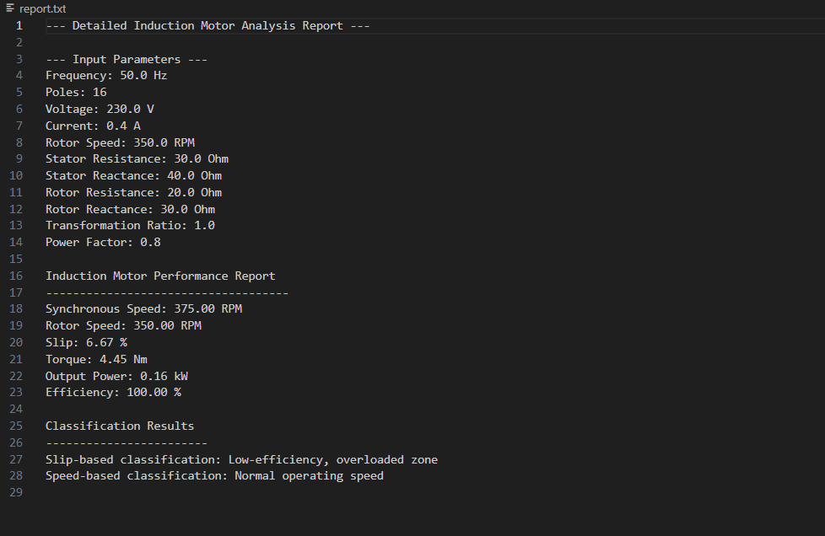
Text file- ‘report.txt’

Slide 20
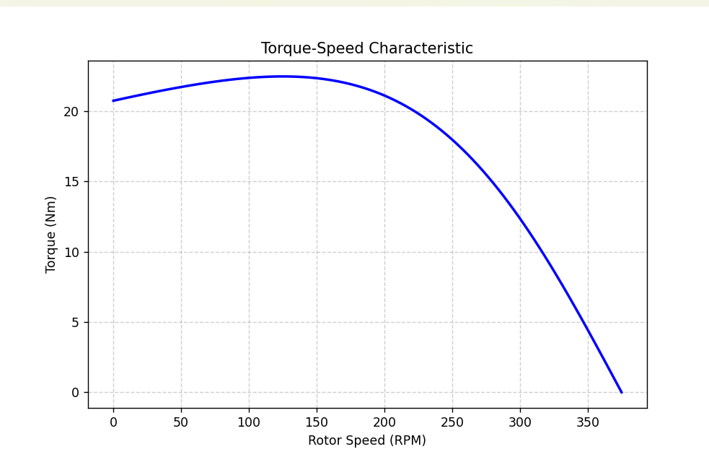
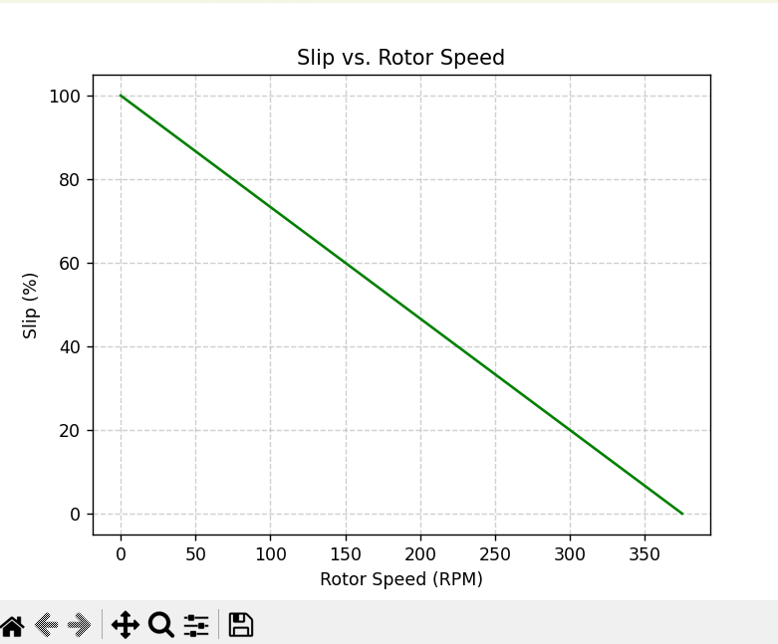
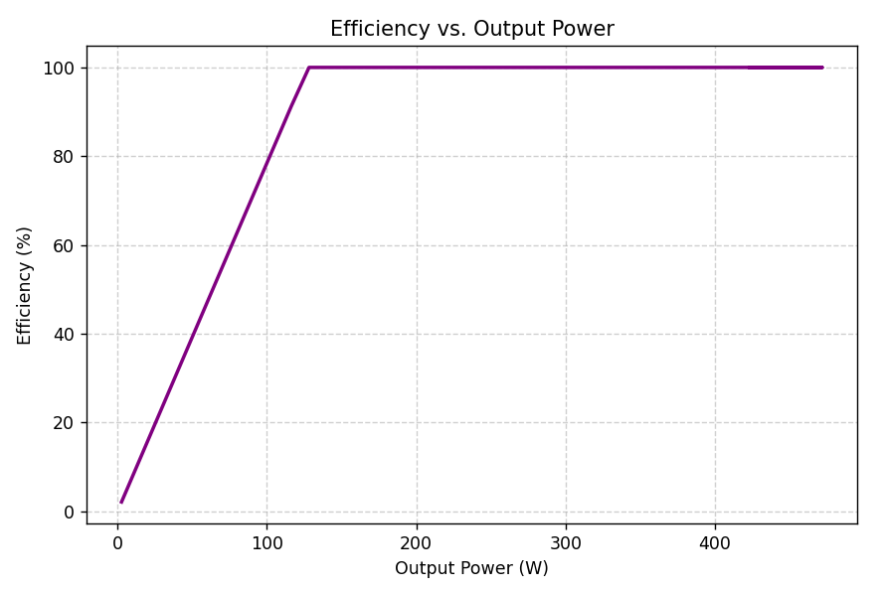

Slide 21
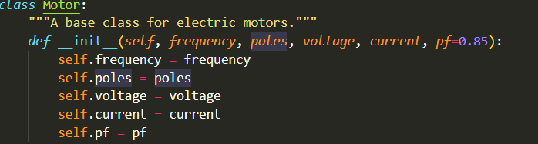
CONCEPTS WE USED
1. Class and Object :

Slide 22
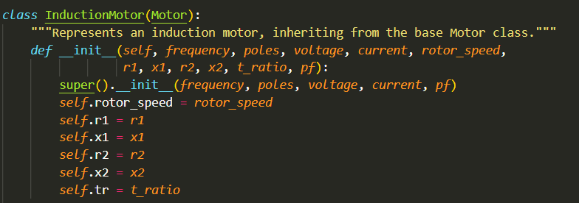
CONCEPTS WE USED
2. inheritance :

Slide 23
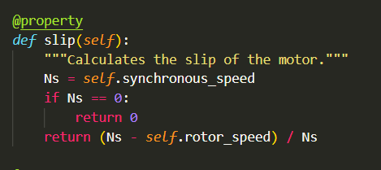
CONCEPTS WE USED
3.PolyMorphism :

Slide 24
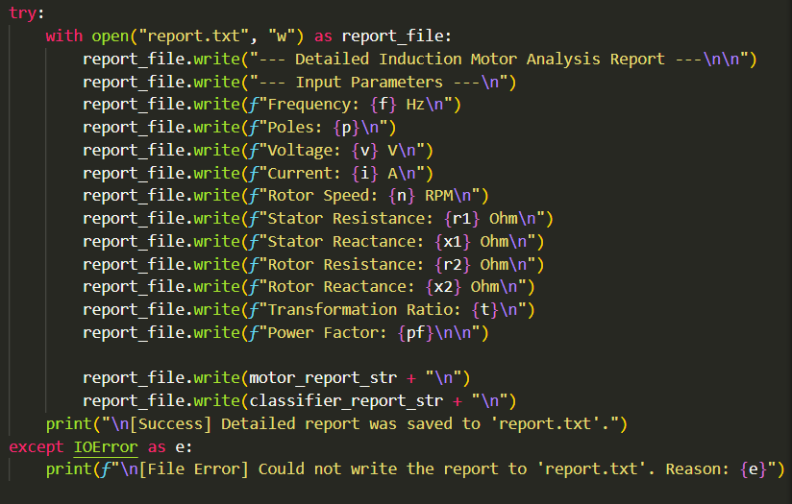
CONCEPTS WE USED
4. Exception Handling :

Slide 25
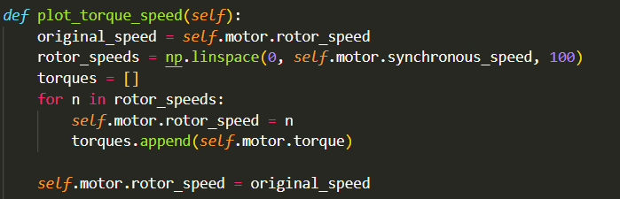
CONCEPTS WE USED
5. Data Visualization(Graphical plot) :

Slide 26
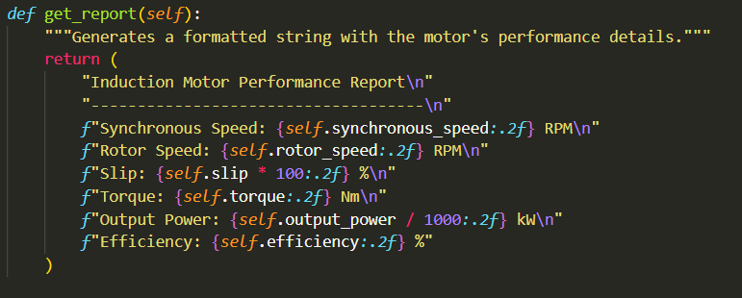
CONCEPTS WE USED
6. Abstraction methods :

Slide 27
The inputs given are frequency, poles, voltage,
Current, stator resistance, stator reactance,
rotor resistance, rotor reactance,
transformation ratio, input power factor
INPUT :

Slide 28
Code Architecture
• Parent Class: Motor — Base for all electric motor types.
• Child Class: InductionMotor — Extends Motor to include rotor and circuit parameters.
Utility Classes :
• Motor Classifier: Classifies slip and speed zones.
• MotorPlotter: Visualizes torque-speed, slip-speed, and efficiency-power relations.

Slide 29
OOP Concepts Implemented
Inheritance – InductionMotor inherits from Motor
Encapsulation – Internal parameters accessed via @property
Abstraction – Complex calculations hidden behind property methods
Polymorphism – Overriding methods for classification and plotting
Exception Handling – Validates user input and file operations

Slide 30
Program Flow
1. User inputs motor parameters.
2. InductionMotor object is created.
3. Performance and classification reports are generated.
4. Report saved to 'report.txt'.
5. Performance plots displayed using Matplotlib and Seaborn.

Slide 31
Visualization Outputs
• Torque-Speed Characteristic Curve
• Slip vs Rotor Speed
• Efficiency vs Output Power
(Graphs generated using Matplotlib and Seaborn libraries.)

Slide 32
Exception Handling & Reporting
Input validation ensures realistic motor parameters.
File writing with error trapping.
User-friendly feedback and logging.
Automatic generation of 'report.txt' summarizing analysis.

Slide 33
Project Outcomes
Developed modular, reusable OOP code for motor performance analysis.
Integrated data visualization and automated report generation.
Demonstrated advanced OOP principles through practical application.

Slide 34
Thank You
THANK
YOU

